Slide 1
Using the TeamsJS SDK V2 to extend your Microsoft Teams solutions to Outlook and Office
Bob German Cloud Developer Advocate Microsoft

Slide 2













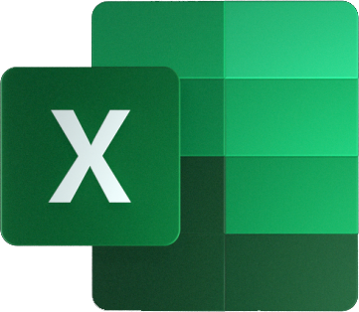
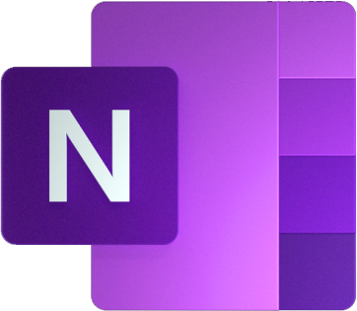
Microsoft 365 Software Development Kits
Client-side library
Microsoft Authentication Library (MSAL)
Microsoft Graph SDK
PnP JS SDK
Teams JavaScript client SDK
Bot Builder SDK
Software Development Kits (SDKs)
Teams client
REST API secured by Azure AD
Microsoft Graph
SharePoint REST API (native)
Azure Active Directory
Azure Bot Service
Microsoft Services
Notes:
GRAPH SDK:
BOT BUILDER SDK: Supports C#, JavaScript/TypeScript, Python, and Java

Slide 3



Teams JavaScript SDK v2 Enhancements
Multi-host support
New namespaces
Promises
New API calls
Backward compatible with v1

Slide 4
Capabilities and Hosts
app
appInstallDialog
authentication
calendar
call
chat
dialog
location
mail
media
pages
people
sharing
teamsCore
video
Capabilities: Logical groupings of APIs that provide similar functionality
Hosts: Microsoft 365 applications that can run an app
mail.isSupported() → true
mail.isSupported() → false
mail.isSupported() → false

Slide 5
Query the capabilities to determine available features
mail.isSupported() → false
Use the context.app.hosxt.name to determine themes and views for each host
await microsoftTeams.app.initialize();
const context = await microsoftTeams.app.getContext();
If (context.app.host.name === microsoftTeams.HostName.teams) {
// show theme for Microsoft Teams
}
Notes:
For example we’re in Teams - so here’s how to query for capability vs. theming

Slide 6
Selected capability APIs
Dialog | isSupported() open() registerOnMessageFromParent() sendMessageToDialog() sendMessageToParentFromDialog() submit()
Location | isSupported() getLocation() showLocation()
Mail | isSupported() composeMail() openMailItem()
People | isSupported() selectPeople()
Calendar | isSupported() composeMeeting() composeCalendarItem()
Call | isSupported() startCall()
Chat | isSupported() openChat() openGroupChat()
Notes:
Note that these don’t replace the Graph API! They act on the client, and many are also available as deep links in Teams.

Slide 7
demo
App in Teams, Office, and Outlook
https://aka.ms/teamssdk-v2-sample (preview)
Notes:
Show tab in Teams
Show tab in Office
Show tab in Outlook
Show messaging extension in Outlook

Slide 8
Next Steps
Quick Upgrade
Resources
1. Install the new SDK npm install --save @microsoft/teams-js
2. Update your app manifest
Teams-only apps: 1.12
Teams apps extended to Office or Outlook (preview) 1.13
3. Over time update your code
check capabilities/hosts
callbacks → promises
new namespaces
Built tabs and other hosted experiences with Teams JS SDK v2
https://aka.ms/TeamsSDK-V2
Try out a sample
https://aka.ms/teamssdk-v2-sample
NPM package https://www.npmjs.com/package/@microsoft/teams-js/

